Slide 1
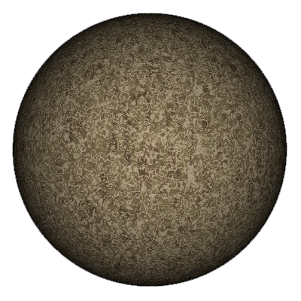
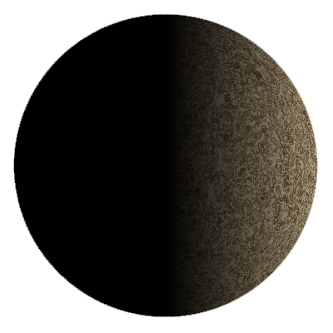
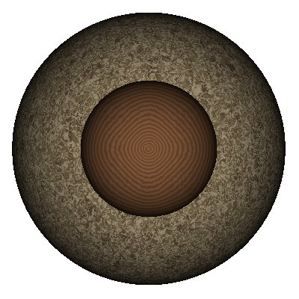
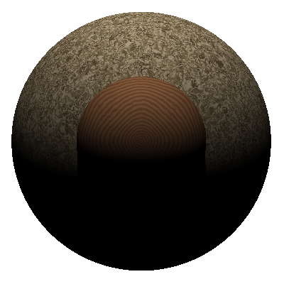
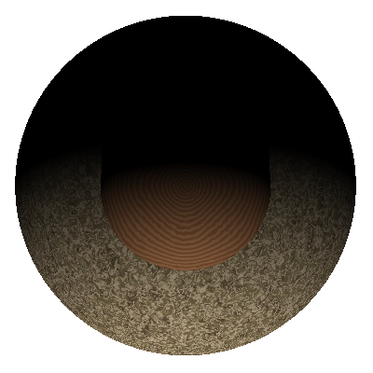
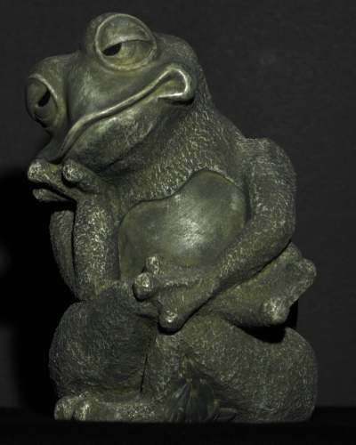
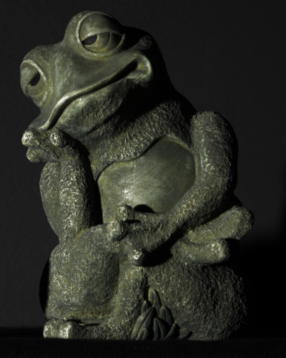
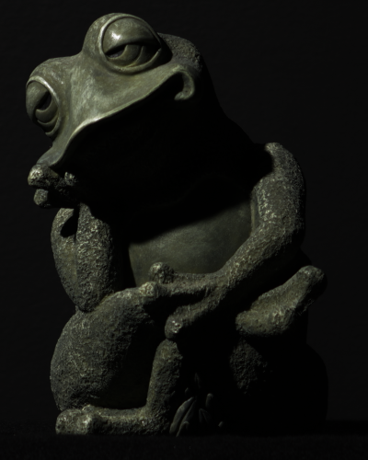
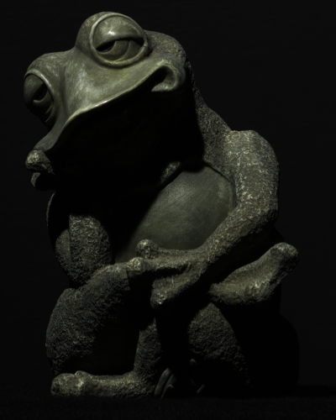
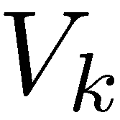
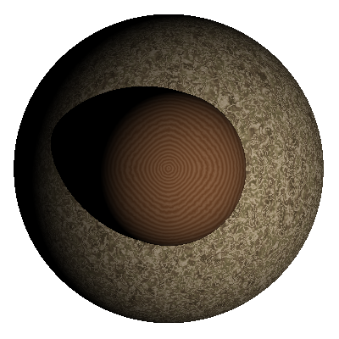
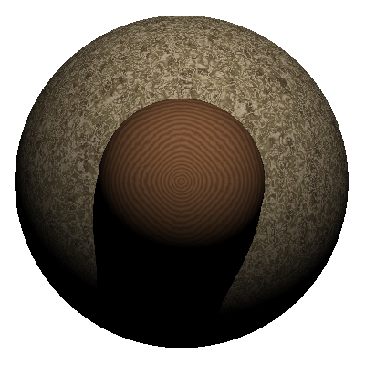
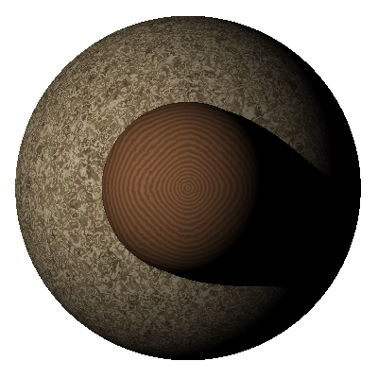
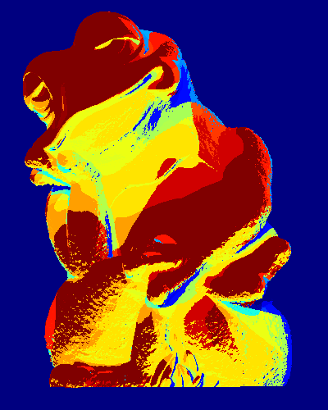
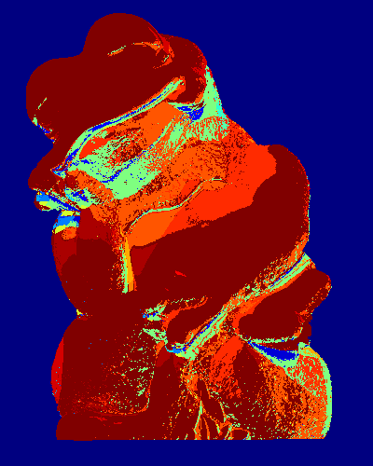
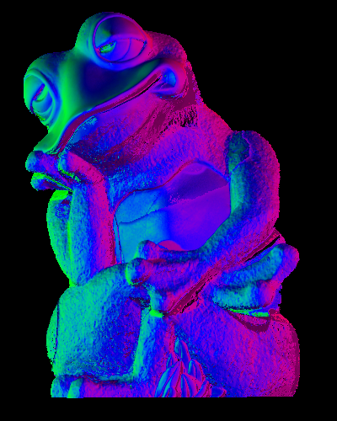
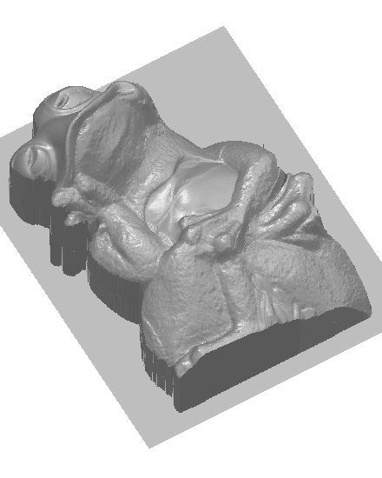
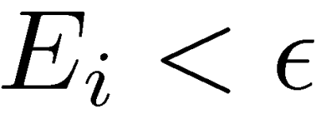
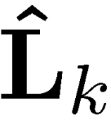
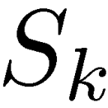
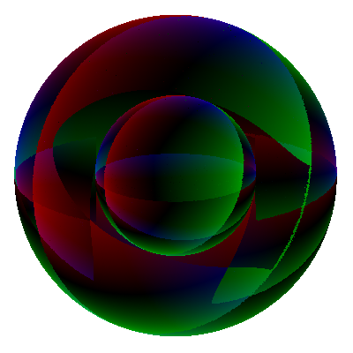
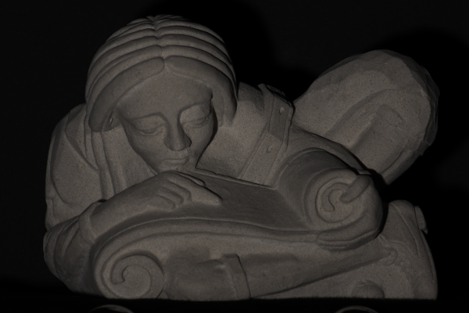
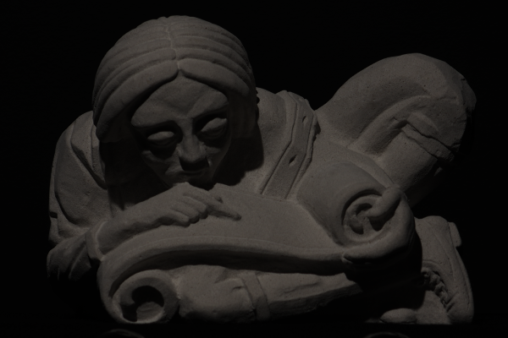
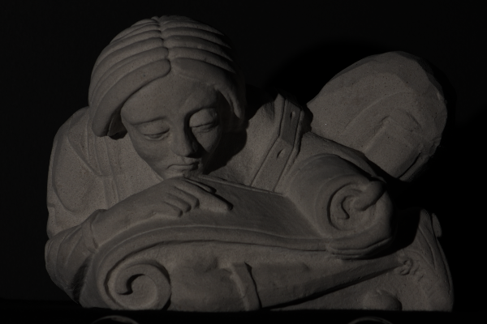
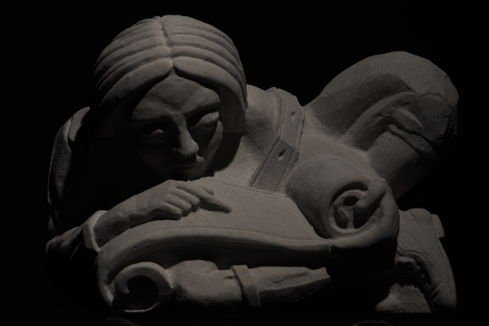
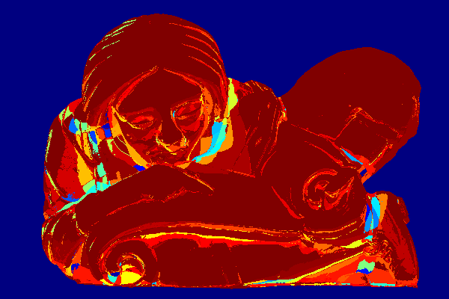
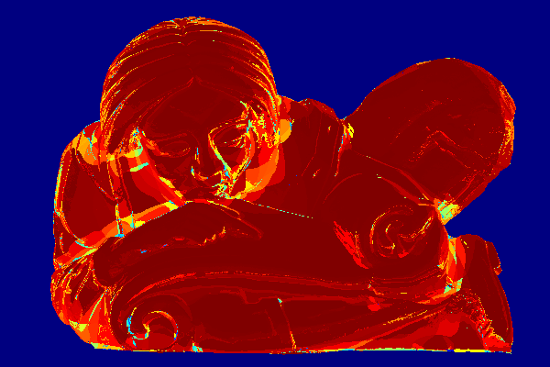
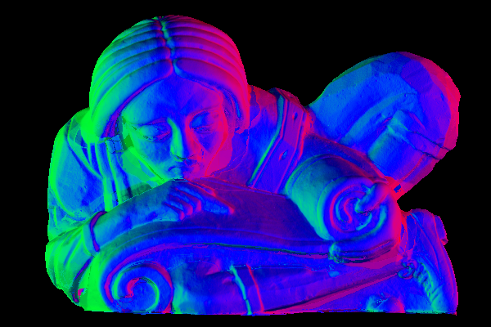
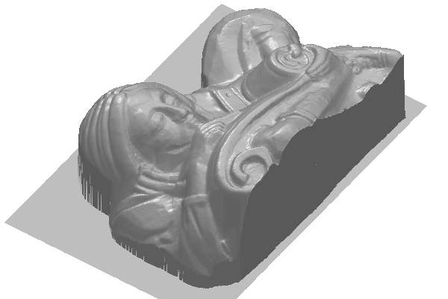
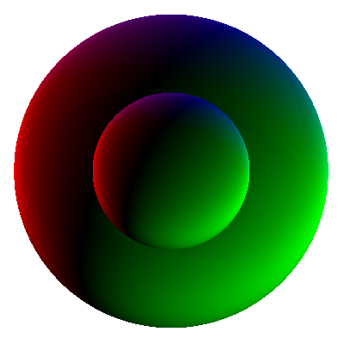
Visibility Subspaces: Uncalibrated Photometric Stereo with Shadows
Kalyan Sunkavalli, Todd Zickler, and Hanspeter Pfister Harvard University
Shadows and Scene Appearance
Lambertian Scene
1
1 | 2 | 3 | 4 | 5
Scene points with same visibility
Rank-3 subspaces
of image matrix
1
A
B
C
D
 |  |  | 0 | 0
 | 0 |  |  | 0
 | 0 | 0
 |  | 0 | 0
N_{A}
 | N_{B}
 |  | N_{C}
 |  |  | N_{D}
L₁ | L₂ | L₃ | 0 | 0
L₁ | 0 | L₃ | L₄ | 0
L₁ | 0 | 0 | L₄ | L₅
L₁ | L₂ | 0 | 0 | L₅
5
A
D
(Visibility Subspaces)
2
3
=
2
Dimensionality of scene appearance with (cast) shadows
The set of all images of a Lambertian scene illuminated by any combination of n directional light sources lies in a linear space with dimension at most 3(2^{n}).
4
4
5
B
C
3
Scene
Images
Visibility regions
Image matrix
Normals
Lights
Uncalibrated Photometric Stereo using Visibility Subspaces
Results
For a Lambertian scene illuminated by lights , intensities at points in a subspace with visibility are given by:
Estimating Visibility Subspaces
Key Idea: Find subspaces by constructing lighting bases from randomly sampled points, and checking how many other points project onto these bases with low error (RANSAC).
Sample three points in scene and estimate lighting basis:
Compute normals at all other points using this lighting basis:
Compute error of estimated lights and normals at every point:
Mark points with error as inliers. Compute lighting basis from all inliers.
Repeat 1 through 4. Mark largest inlier-set found as subspace with lighting .
Repeat 1 through 5 until all visibility subspaces have been recovered.
Images
Input images (4 of 8)
True subspaces
True subspaces
Estimated subspaces
Normals
Depth
Subspaces to surface normals
Key Idea: Estimate visibilities from subspaces, and use them to recover normals.
Subspace clustering recovers normals up to a linear 3X3 ambiguity in each subspace:
From , compute visibility:
Using visibility, recover surface normals up to a single global linear 3X3 ambiguity by solving an over-constrained system of linear equations for global lighting and subspace ambiguities :
Estimated subspaces
Subspace normals
Input images (4 of 12)
True subspaces
Estimated subspaces
Normals
Depth
Transformed normals

