Slide 1
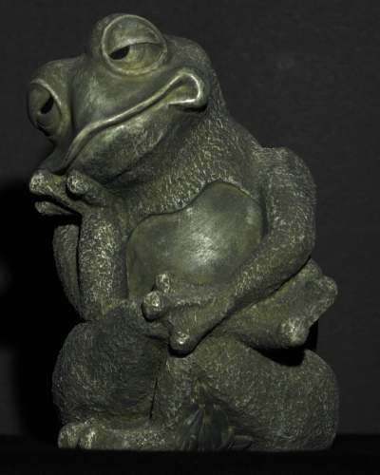
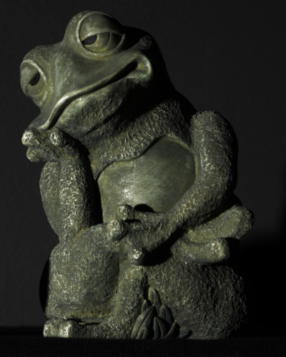
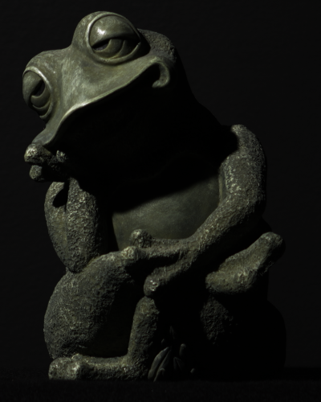
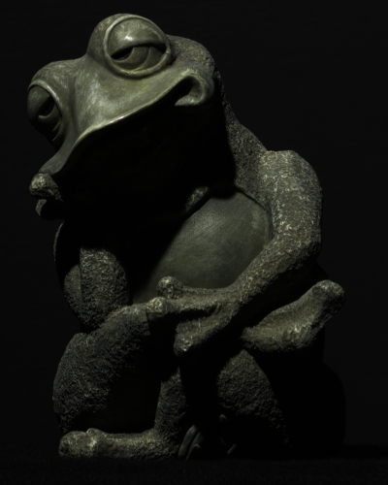
Visibility Subspaces: Uncalibrated Photometric Stereo with Shadows
Kalyan Sunkavalli, Harvard University
Joint work with Todd Zickler and Hanspeter Pfister
Published in the Proceedings of ECCV 2010
http://gvi.seas.harvard.edu/

Slide 2
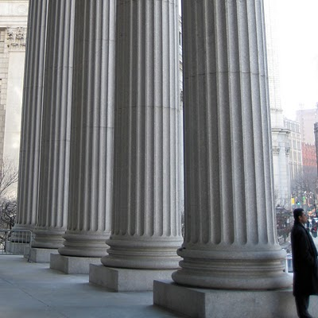
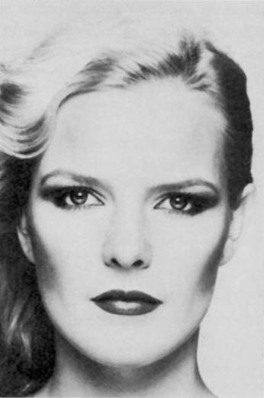
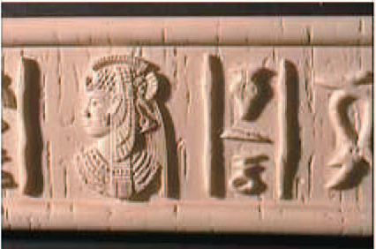
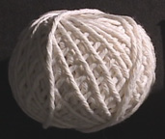
Shading contains strong perceptual cues about shape

Slide 3
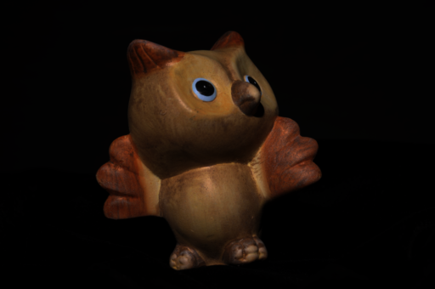
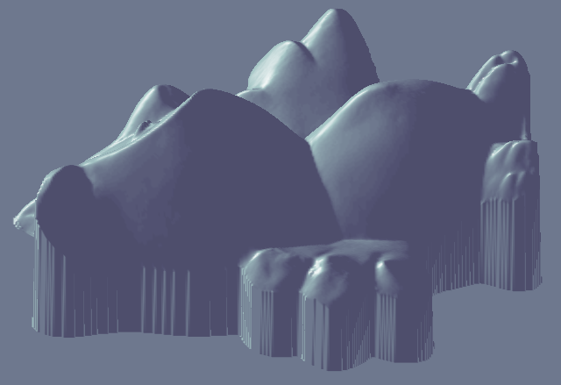
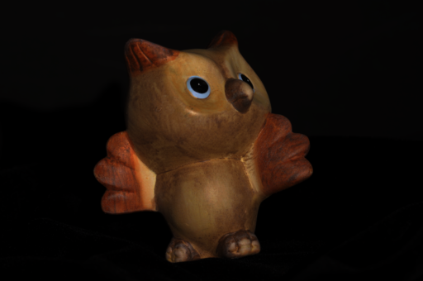
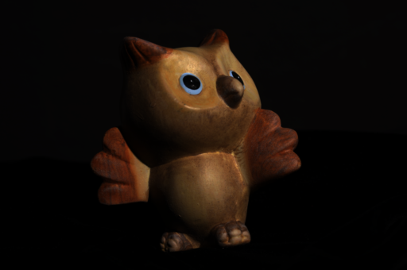
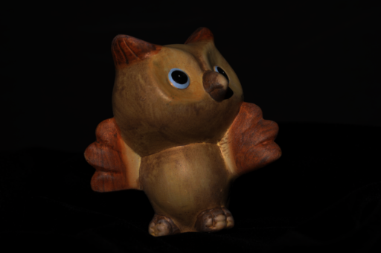
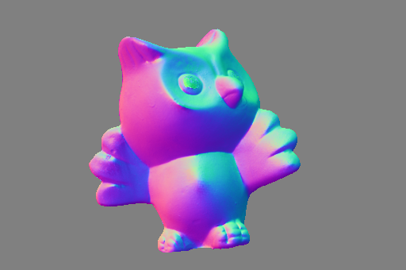
Photometric Stereo
Use multiple images captured under changing illumination and recover per-pixel surface normals.
Originally proposed for Lambertian surfaces under directional lighting. Extended to different BRDFs, environment map illumination, etc.
One (unavoidable) issue: how to deal with shadows?

Slide 4
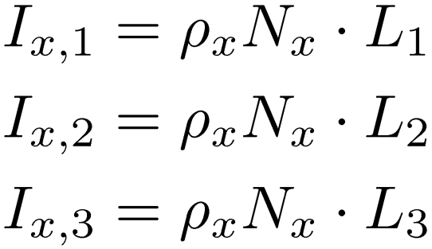
Lambertian Photometric Stereo

Slide 5
Lambertian Photometric Stereo
pixels
lights

Slide 6
Lambertian Photometric Stereo
Images of a Lambertian surface under directional lighting form a Rank-3 matrix.
[ Shashua ’97 ]

Slide 7
Lambertian Photometric Stereo
Images of a Lambertian surface under directional lighting form a Rank-3 matrix.
Photometric Stereo (calibrated lighting)
[ Woodham ’78, Silver ’80 ]

Slide 8
Lambertian Photometric Stereo
Images of a Lambertian surface under directional lighting form a Rank-3 matrix.
Photometric Stereo (uncalibrated lighting)
Ambiguity
[ Hayakawa ’94, Epstein et al. ’96, Belhumeur et al. ‘99 ]

Slide 9
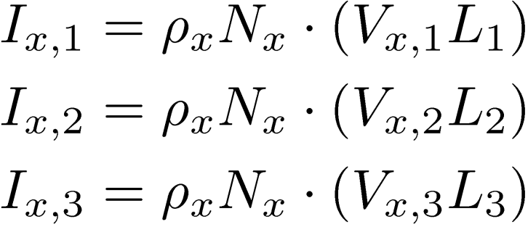
Shadows in Photometric Stereo

Slide 10
Shadows in Photometric Stereo
Photometric Stereo (calibrated lighting)
Photometric Stereo (uncalibrated lighting)
(factorization with missing data)

Slide 11
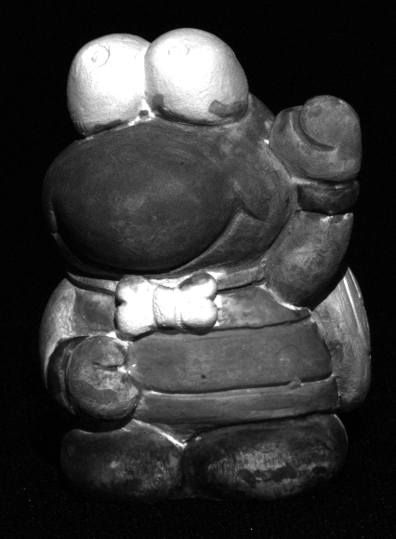
Shadows in Photometric Stereo
Previous work: Detect shadowed pixels and discard them.
Intensity-based thresholding
Threshold requires (unknown) albedo
Use calibrated lights to estimate shadows
[ Coleman & Jain ‘82, Chandraker & Kriegman ’07 ]
Smoothness constraints on shadows
[ Chandraker & Kriegman ’07, Hernandez et al. ’08 ]
Use many (100s of) images.
[ Wu et al. ’06, Wu et al. 10 ]

Slide 12
Shadows in Photometric Stereo
Our work analyzes the effect of shadows on scene appearance.
We show that shadowing leads to distinct appearance subspaces.
This results in:
A novel bound on the dimensionality of (Lambertian) scene appearance.
An uncalibrated Photometric Stereo algorithm that works in the presence of shadows.

Slide 13
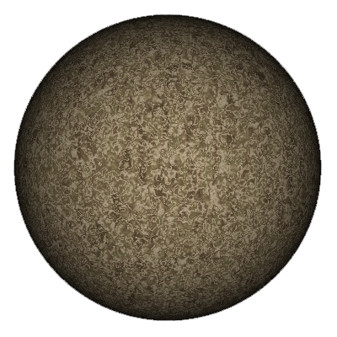
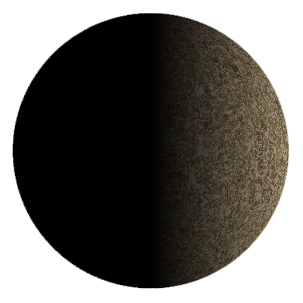
Shadows and Scene Appearance
1
5
1
2
3
2
4
3
4
5
Scene
Images

Slide 14
Shadows and Scene Appearance
{1,2,5}
{1,4,5}
A
D
1
2
3
B
C
{1,2,3}
{1,3,4}
4
5
Visibility Regions
Images

Slide 15
Shadows and Scene Appearance
1 | 2 | 3 | 4 | 5
{1,2,5}
{1,4,5}
A
D
A
B
C
D
 |  |  | 0 | 0
 | 0 |  |  | 0
 | 0 | 0
 |  | 0 | 0
B
C
{1,2,3}
{1,3,4}
Visibility Regions
Image Matrix
Rank-5

Slide 16
Shadows and Scene Appearance
1 | 2 | 3 | 4 | 5
Lambertian points lit
by directional lights
Rank-3 submatrix
A
B
C
D
 |  |  | 0 | 0
 | 0 |  |  | 0
 | 0 | 0
 |  | 0 | 0
Image Matrix
Rank-5

Slide 17
Shadows and Scene Appearance
1 | 2 | 3 | 4 | 5
A
B
C
D
 |  |  | 0 | 0
 | 0 |  |  | 0
 | 0 | 0
 |  | 0 | 0
Different Rank-3 submatrices
Image Matrix
Rank-5

Slide 18
Visibility Subspaces
Scene points with same visibility
Rank-3 subspaces
of image matrix

Slide 19
Visibility Subspaces
Scene points with same visibility
Rank-3 subspaces
of image matrix
Dimensionality of scene appearance with (cast) shadows: Images of a Lambertian scene illuminated by any combination of n light sources lie in a linear space with dimension at most 3(2^{n}).
Previous work excludes analysis of cast shadows.

Slide 20
Visibility Subspaces
Scene points with same visibility
Rank-3 subspaces
of image matrix
Dimensionality of scene appearance with (cast) shadows
Visibility regions can be recovered through subspace estimation (leading to an uncalibrated Photometric Stereo algorithm).

Slide 21
Estimating Visibility Subspaces
Find visibility regions by looking for Rank-3 subspaces
(using RANSAC-based subspace estimation).

Slide 22
Estimating Visibility Subspaces
Sample 3 points and construct lighting basis from the image intensities:

Slide 23
Estimating Visibility Subspaces
Sample 3 points and construct lighting basis from the image intensities:
If points are in same visibility subspace, is a valid basis for entire subspace.

Slide 24
Estimating Visibility Subspaces
Sample 3 points and construct lighting basis from the image intensities:
If points are in same visibility subspace, is a valid basis for entire subspace.
If not, is not a valid basis for any subspace.

Slide 25
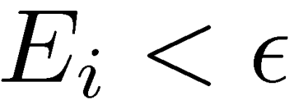
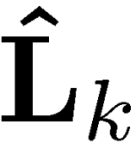
Estimating Visibility Subspaces
Sample 3 points in scene and construct lighting basis from their image intensities:
Compute normals at all points using this basis:
Compute error of this basis:
Mark points with error as inliers.
Repeat 1-4 and mark largest inlier-set found as subspace with lighting basis . Remove inliers from pixel-set.
Repeat 1-5 until all visibility subspaces have been recovered.

Slide 26
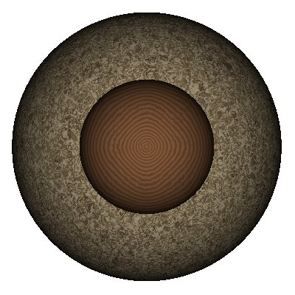
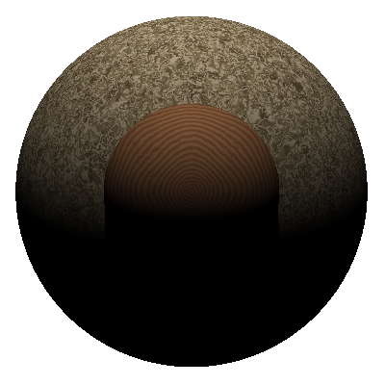
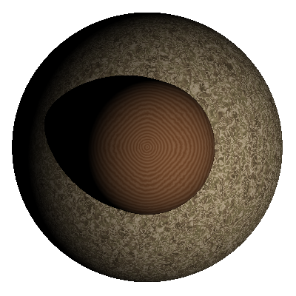
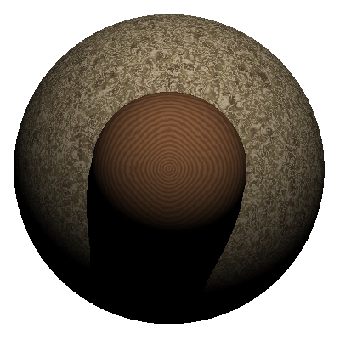
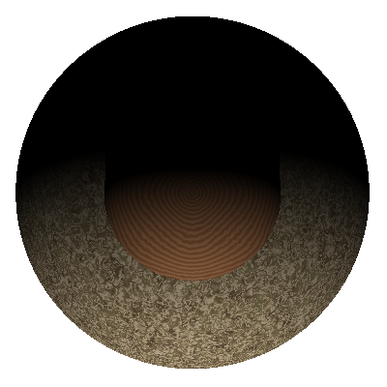
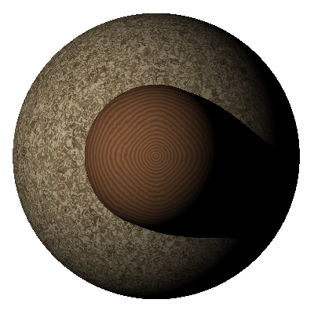
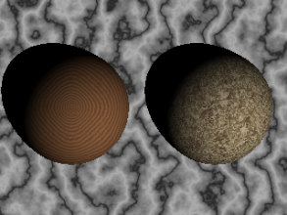
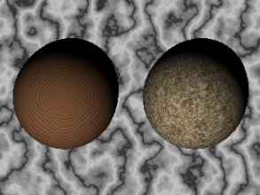
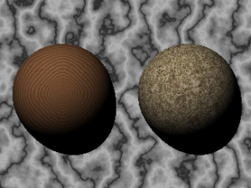
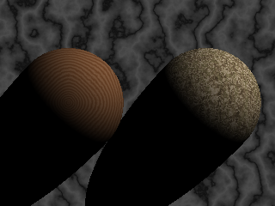
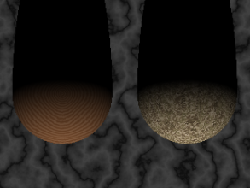
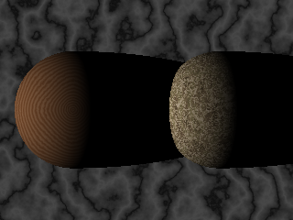
Estimating Visibility Subspaces
Images
True
subspaces
Estimated subspaces

Slide 27
Subspaces to Surface normals
Subspace
Clustering
Image Matrix
Visibility Subspaces
Subspace clustering gives us a labeling of the scene points into regions with same visibility.
Can we figure out the true visibility (and surface normals) from this?

Slide 28
Subspaces to Surface normals
Subspace clustering recovers normals and lights:
Subspace Normals
Subspace
Lights

Slide 29
Subspaces to Surface normals
Subspace clustering recovers normals and lights:
There is a 3X3 linear ambiguity in these normals and lights:
True
Normals
Subspace Ambiguity
True
Lights

Slide 30
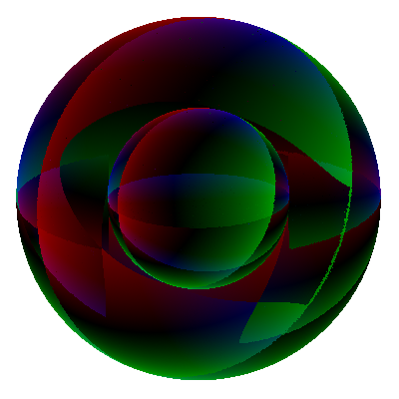
Subspaces to Surface normals
Subspace clustering recovers normals and lights:
There is a 3X3 linear ambiguity in these normals and lights:
True
Normals
Subspace Ambiguity
True
Lights
Estimated subspaces
Subspace normals
Images

Slide 31
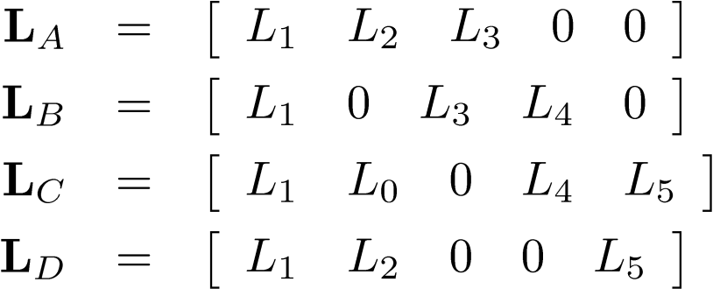
Subspaces to Surface normals
1 | 2 | 3 | 4 | 5
A
B
A
B
C
D
 |  |  | 0 | 0
 | 0 |  |  | 0
 | 0 | 0
 |  | 0 | 0
D
C

Slide 32
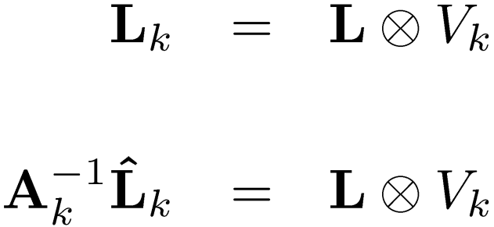
Subspaces to Surface normals
1 | 2 | 3 | 4 | 5
A
B
A
B
C
D
 |  |  | 0 | 0
 | 0 |  |  | 0
 | 0 | 0
 |  | 0 | 0
D
C

Slide 33
Subspaces to Surface normals
1 | 2 | 3 | 4 | 5
A
B
A
B
C
D
 |  |  | 0 | 0
 | 0 |  |  | 0
 | 0 | 0
 |  | 0 | 0
D
C
Subspace ambiguity
Visibility
Subspace light basis
(from clustering)
True
lights

Slide 34
Subspaces to Surface normals
1 | 2 | 3 | 4 | 5
A
B
A
B
C
D
 |  |  | 0 | 0
 | 0 |  |  | 0
 | 0 | 0
 |  | 0 | 0
D
C

Slide 35
Subspaces to Surface normals
1 | 2 | 3 | 4 | 5
A
B
A
B
C
D
 |  |  | 0 | 0
 | 0 |  |  | 0
 | 0 | 0
 |  | 0 | 0
D
C
Visibility of subspace
Magnitude of subspace light basis
independent of scene properties

Slide 36
Subspaces to Surface normals
1 | 2 | 3 | 4 | 5
A
B
A
B
C
D
 |  |  | 0 | 0
 | 0 |  |  | 0
 | 0 | 0
 |  | 0 | 0
D
C
Subspace ambiguity
(unknown)
Visibility
(computed from subspace lighting)
Subspace light basis
(from clustering)
True lights (unknown)

Slide 37
Subspaces to Surface normals
1 | 2 | 3 | 4 | 5
A
B
A
B
C
D
 |  |  | 0 | 0
 | 0 |  |  | 0
 | 0 | 0
 |  | 0 | 0
D
C
Linear system of equations
Solve for ambiguities and true light sources
Avoid trivial solution ( ) by setting
Transform subspace normals by estimated ambiguities

Slide 38
Subspaces to Surface normals
Images
Subspace
normals
Transformed
normals

Slide 39
Visibility Subspaces
Subspace
Clustering
Image Matrix
Visibility Subspaces
Visibility, Subspace ambiguity estimation
Surface normals

Slide 40
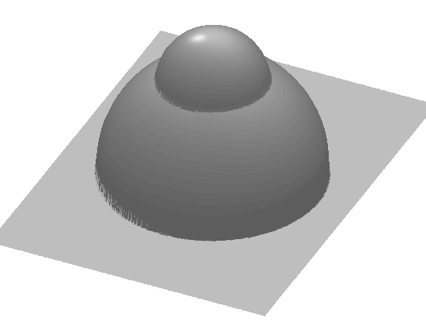
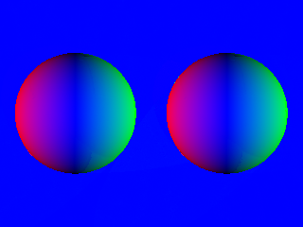
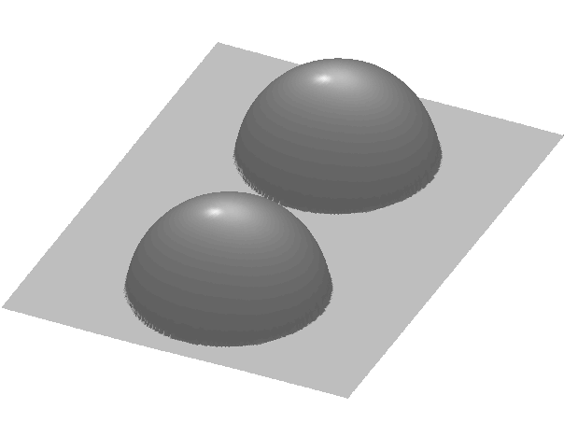
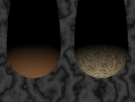
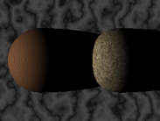
Results (synthetic data)
Images
Estimated
subspaces
Estimated
normals
Estimated
depth

Slide 41
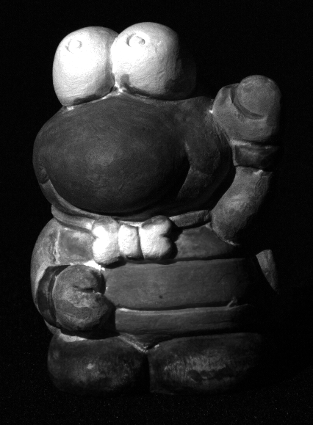
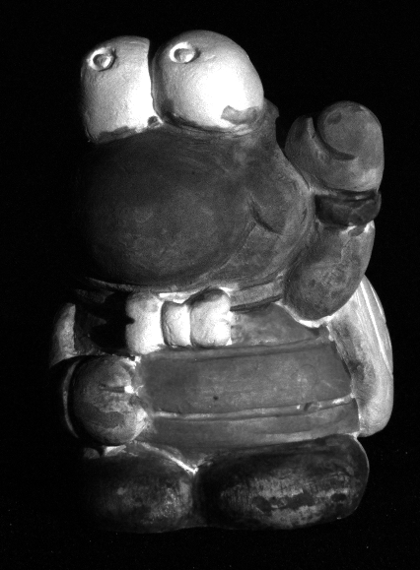
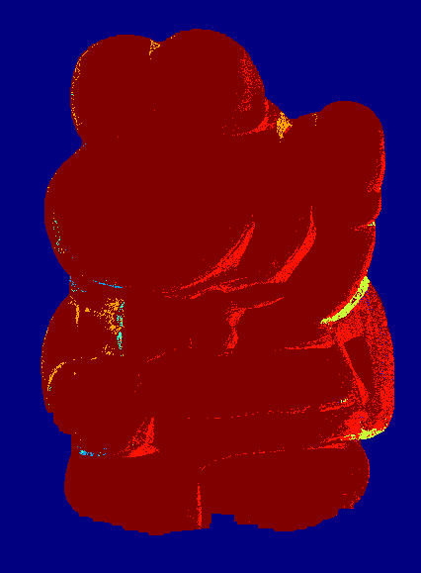
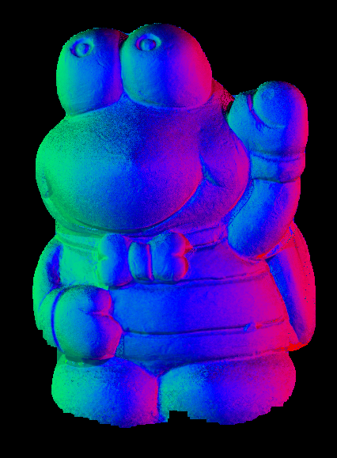
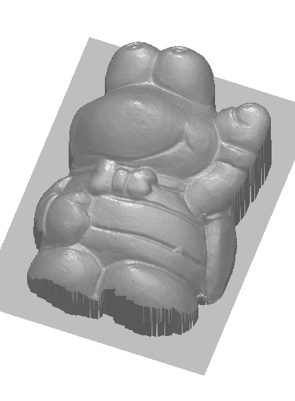
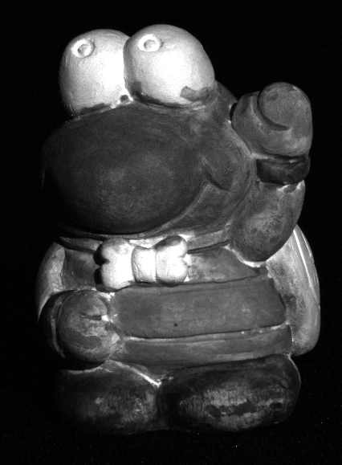
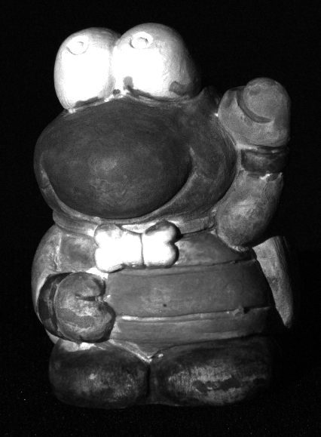
Results (captured data)
Estimated
subspaces
Estimated
normals
Estimated
depth
5 Images

Slide 42
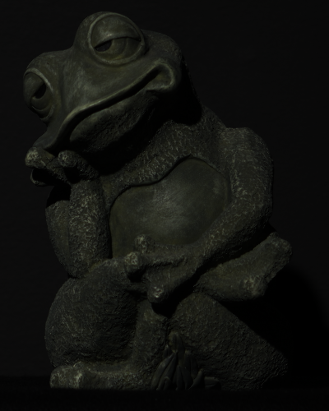
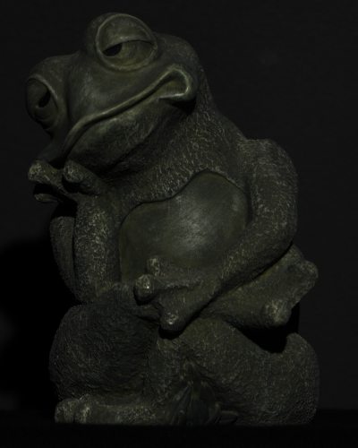
“True” subspaces
“Ground truth”
normals
Estimated
depth
Estimated subspaces
Estimated normals
8 Images

Slide 43
12
Images
12 Images
“True” subspaces
“True” normals
Estimated depth
Estimated subspaces
Estimated normals

Slide 44
Some issues
Degeneracies
Rank-deficient normals
Explicitly handle these in subspace estimation and normal recovery
Deviations from Lambertian reflectance
Specify RANSAC error threshold appropriately
Stability of subspace estimation
Intersections between subspaces
Large number of images, complex geometry

Slide 45
Conclusions
An analysis of the influence of shadows on scene appearance.
A novel bound on the dimensionality of scene appearance in the presence of shadows.
An uncalibrated Photometric Stereo algorithm that is robust to shadowing.
Extend analysis to mutual illumination
Add spatial constraints
Extend to more general cases (arbitrary BRDFs and illumination)

Slide 46
Thank you!
http://gvi.seas.harvard.edu

