Slide 1
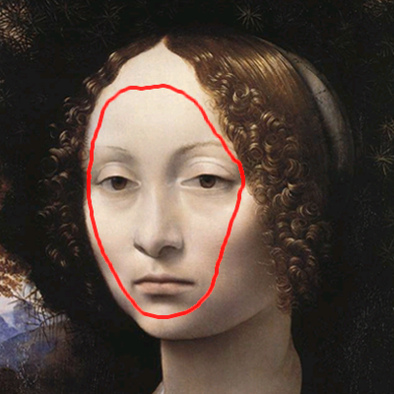
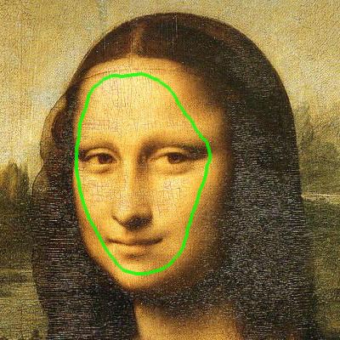
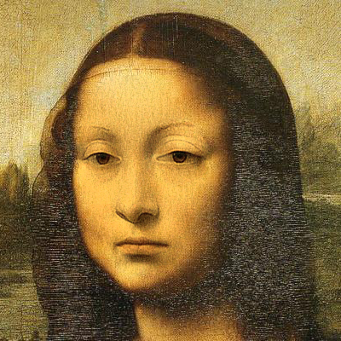
Multi-scale Image Harmonization
Kalyan Sunkavalli | Micah K. Johnson | Wojciech Matusik | Hanspeter Pfister
Harvard University | MIT | Disney Research Zurich | Harvard University
Notes:
Thank you for the introduction, Dan and thank you everyone for coming to this talk.

Slide 2
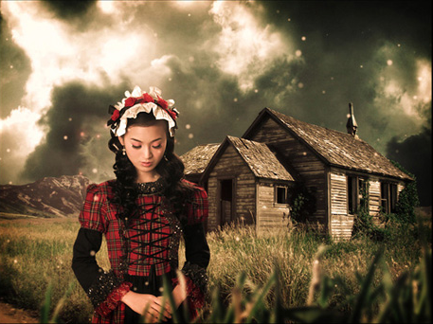
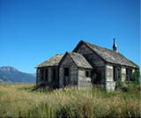
Image Compositing
luxa.org
Notes:
Image compositing is the process of combining elements from different photographs to create a single image.

Slide 3
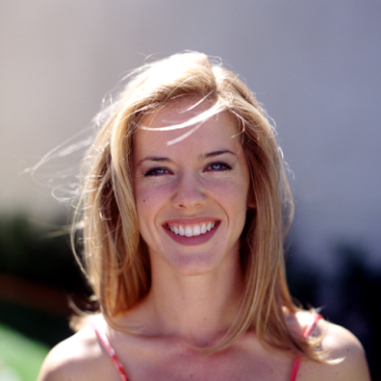
Current approaches
Alpha Matting
Combine pixel values to create blended boundaries
[ Porter & Duff ’84, Smith & Blinn ’96, … ]
Chuang et al. ’01
Notes:
Traditionally this is done using alpha matting where pixel values are combined using an alpha matte to create composites with blended boundaries.

Slide 4
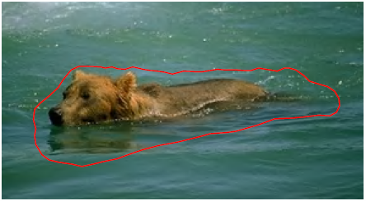
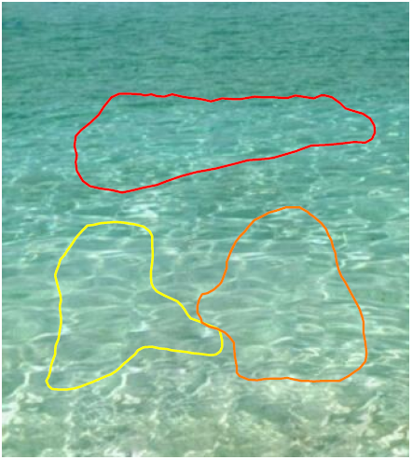
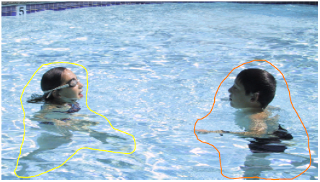
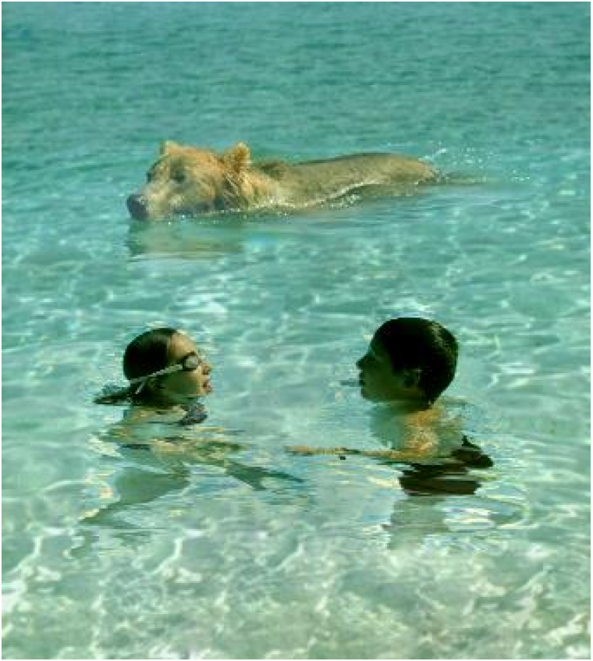
Current approaches
Alpha Matting
Combine pixel values to create blended boundaries
[ Porter & Duff ’84, Smith & Blinn ’96, … ]
Gradient-domain fusion
Combine pixel gradients to create seamless boundaries
[ Pérez et al. ’03, Agarwala et al. ‘04, … ]
Pérez et al. ’03
Notes:
Another approach that has become popular recently is gradient-domain fusion where pixel gradients are combined to create composites with seamless boundaries. So the idea in both alpha matting and gradient-domain fusion is to ensure that the boundaries between the images being composited are as natural as possible.

Slide 5
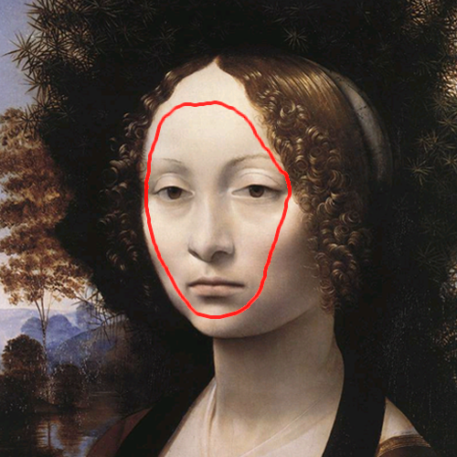
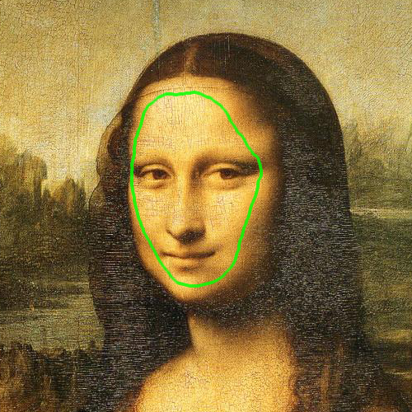
What if the images are incompatible?
Notes:
While this is of course very important, it is not always enough. And we can confirm this by seeing what happens when we composite two images that differ in their appearance. So here we have images of two Da Vinci paintings. As you can see, the face on the left is smoother while the image on the right has a textured appearance.

Slide 6
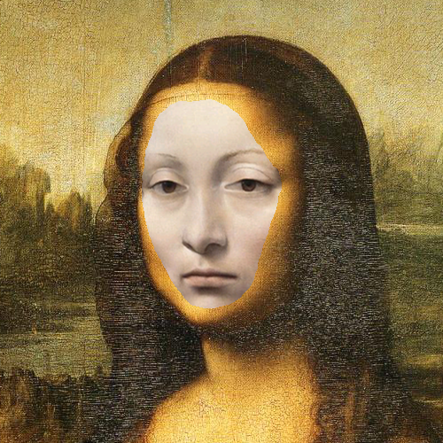
Copy & paste
Notes:
Just copying the face on the left and pasting it into the image in the right creates a bad composite because the seam between the two regions is obvious

Slide 7
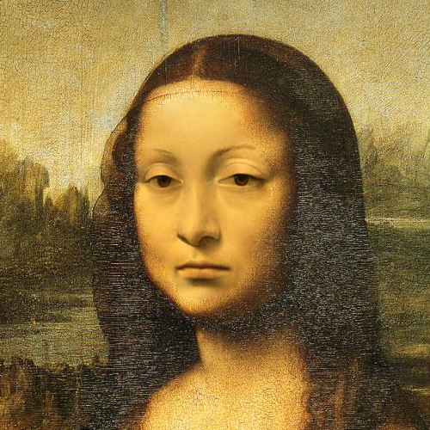
Gradient-domain fusion
Notes:
Using gradient-domain fusion we can get rid of the seam and this improves the quality of the result. However, because of the difference in the textures of the images we started out with you can see perceive a boundary in this composite. Fixing these differences would normally take a lot of tedious manual work.

Slide 8
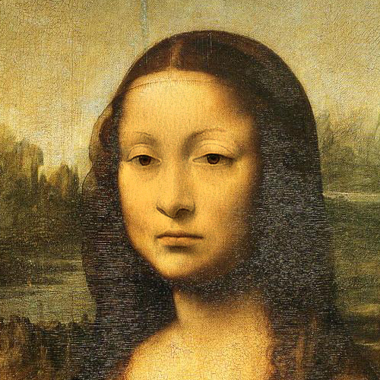
Our
result
Notes:
But our work can fix these differences by matching the appearance of the two images automatically.

Slide 9
Gradient-domain fusion
Our result
Notes:
And as you can seen from this comparison between the previous result and our result, to create a high-quality composite we need to ensure that the boundary is natural, but we also need to take care that the images we composite are similar in their appearance.

Slide 10
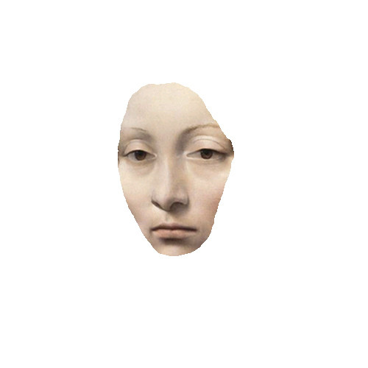
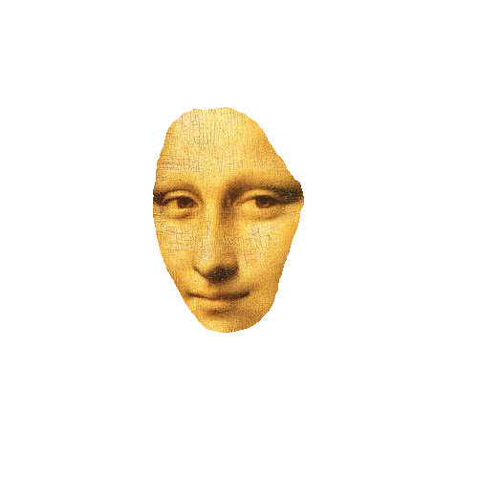
Given two images,
“harmonize” them
(i.e. match their appearance),
and then composite them
(with plausible boundaries).
Notes:
So the goal of our work is to, take the images that need to be composited, automatically “harmonize” their appearance, and then, composite them while ensuring that the boundaries are natural.

Slide 11
Multi-scale Image Harmonization
Harmonization
Color
Contrast
Noise
Texture
Blur
Compositing
Matte-based boundaries
Seamless boundaries
Notes:
In particular, while harmonizing the images we’d like to match their color, contrast, noise, texture, and blur, and while compositing them we’d like to be able to incorporate both matte-based boundaries and seamless boundaries .

Slide 12
Overview
Notes:
Before going into the details, I’ll first start with a quick overview of our Multi-scale Image Harmonization framework. The inputs to our technique are the two images that need to be composited as well as a specification of the kinds of boundaries the user would like in the result.

Slide 13
Overview
Notes:
We start by constructing pyramids from the source and target images…

Slide 14
Overview
Notes:
And use a novel Smooth Histogram Matching technique to modify the source image pyramid to create a harmonized pyramid whose appearance matches the appearance of the target pyramid.

Slide 15
Overview
Notes:
Using our pyramid compositing scheme, we then reconstruct the final composite from the harmonized pyramid while incorporating the boundary conditions.

Slide 16
Overview
Notes:
While our Smooth Histogram Matching technique can match the appearance of many images, it may not be able to resolve large differences in noise or texture. To account for this we introduce a noise matching component that allows us to compensate for these large differences. All these components put together constitute our multi-scale harmonization framework.

Slide 17
Overview
Notes:
And as you can see, the smooth histogram matching and the noise matching modules together form the “Harmonization” part of our pipeline…

Slide 18
Overview
Notes:
…while the Pyramid compositing module is the compositing part of our pipeline.

Slide 19
Overview
Notes:
I’ll now discuss each component of our framework in detail starting with our Smooth Histogram Matching technique.

Slide 20
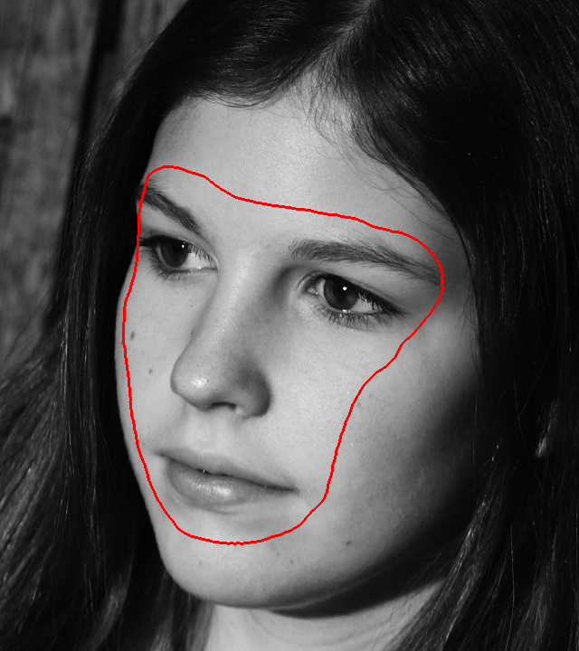
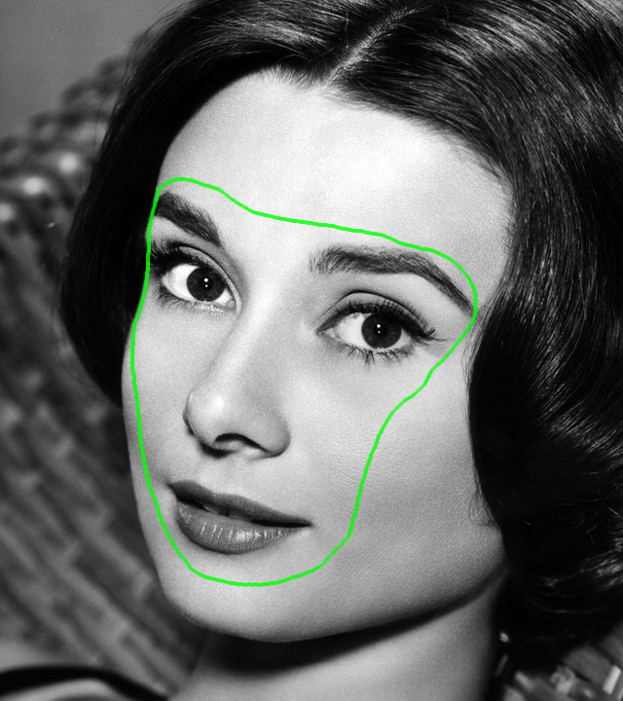
Starstock / Photoshot
Source
Target
Notes:
And I’ll work through each step using this running example, where we’d like to take the face of the girl from the source image on the left and composite it with the target photograph of Audrey Hepburn on the right.

Slide 21
Build
pyramids
Source
Target
Notes:
We start by building pyramids for both the source and target images

Slide 22
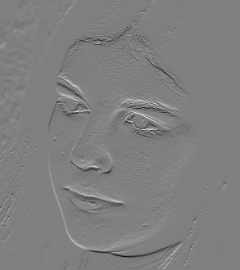
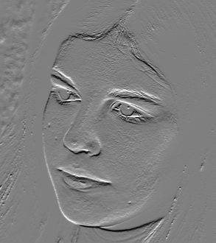
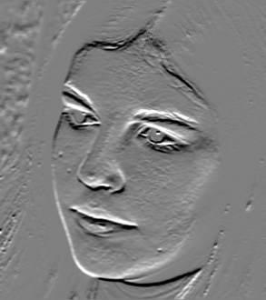
* f₁
* f₂
…
Image
* f_{n}
Undecimatedpyramid subbands
Analysis filters
[ Burt ‘81, Burt & Adelson ’83 ]
Notes:
Pyramids are traditionally built by filtering the input image with a set of linear analysis filters. Each filter has a different scale and orientation and results in a pyramid subband that capture the information in the original image at that particular scale and orientation. Pyramids have been widely used in Vision and Graphics for problems as diverse as compression, recognition, texture synthesis, etc., but in this case we will show that they are a very useful representation for “harmonizing” and compositing images. ***A few things to note about the way we construct our pyramids: we use Haar filters though you could use any linear filter, and we do not downsample the pyramid subbands as is usually done in multi-scale methods.***

Slide 23
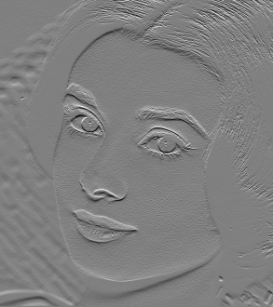
Build
pyramids
Source
Target
Source
subbands
Target
subbands
Notes:
Filtering the source and target images with our analysis filters give us a set of pyramid subbands for each image.

Slide 24
Source
Target
Source
subbands
Source
subband histograms
Target
subband histograms
Target
subbands
Notes:
Now the coefficients in each of these subbands will have distributions that are captured by their histograms. It is known from previous work that these distributions are closely related to the appearance of the image itself, in terms of what the contrast is, whether it has a textured appearance or not, how noisy it is, etc.

Slide 25
Source
Target
Histogram
Matching
Source
subbands
Source
subband histograms
Target
subband histograms
Target
subbands
[ Heeger & Bergen ’95 ]
Notes:
And this has been leveraged in work on texture synthesis, where it has been shown that by modifying the source subbands so that their histograms match the histograms of the target subbands, you can reproduce textures with the appearance of the input texture.

Slide 26
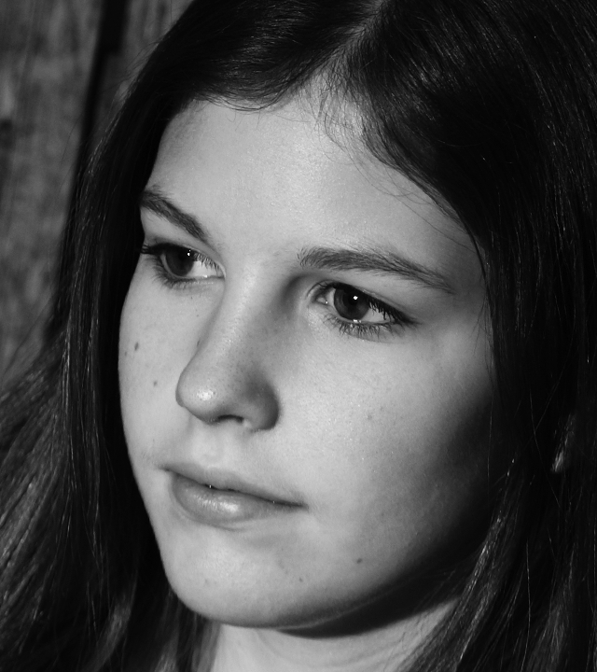
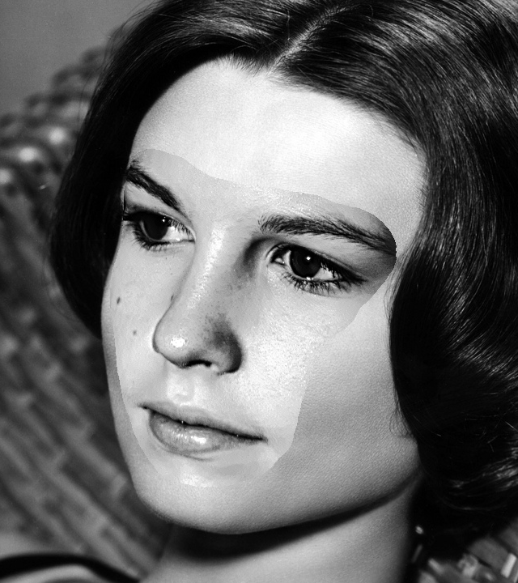
Source
Notes:
If you use this histogram matching technique to transfer the appearance of the Audrey Hepburn photograph to the source image we started out with

Slide 27
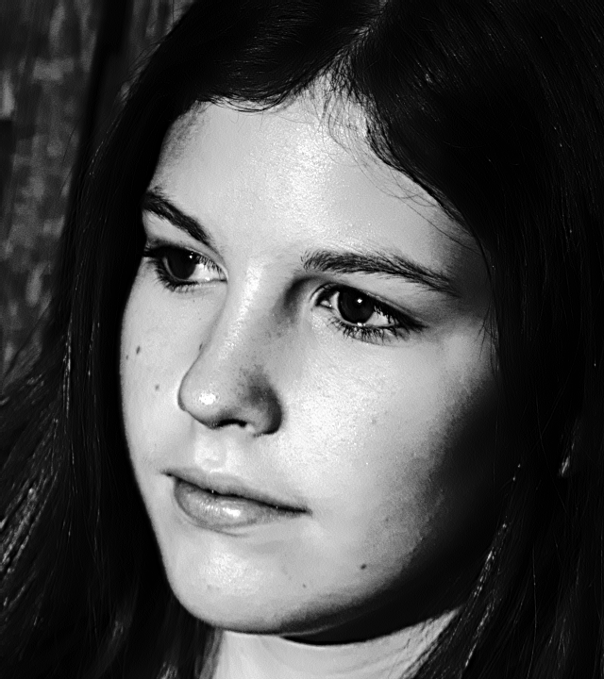
Histogram
matching
Notes:
You get this result where we have approximately matched the appearance of the two images…

Slide 28
Over-sharpening
Haloing
Histogram
matching
Notes:
But at the cost of creating a number of artifacts including the haloing near strong edges and these ugly blotches on the skin. A composite created from this result would not be very good.

Slide 29
Source
Target
Histogram
Matching
Source
subbands
Source
subband histograms
Target
subband histograms
Target
subbands
Notes:
So why does matching the histogram of the subbands produce a result like this

Slide 30
Histogram Matching as a Gain function
Histogram
Matching
Source
subband
"Harmonized"
subband
Target
subband
Notes:
We can understand this by looking at what histogram matching does. Histogram matching the source subbands gives us a set of “harmonized” subbands whose statistics match the statistics of the target subbands.

Slide 31
Histogram Matching as a Gain function
Histogram
Matching
Source
subband
"Harmonized"
subband
"Harmonized"
subband values
Source subband
values
Notes:
So you can think of histogram matching as some arbitrary non-linear mapping between the source subbands and the “harmonized” subbands

Slide 32
Histogram Matching as a Gain function
Histogram
Matching
Source
subband
"Harmonized"
subband
"Harmonized"
subband values
"Harmonized"
Gain
=
Source
Source subband
values
Source subband
values
Notes:
We can divide the “harmonized” and source subbands values to construct a gain function that basically tells us how much to scale each source subband value to obtain the “harmonized” subband values.

Slide 33
Histogram Matching as a Gain function
Source
subband
"Harmonized"
subband
Gain function
"Harmonized"
subband values
"Harmonized"
Gain
=
Source
Source subband
values
Source subband
values
Notes:
So we can interpret histogram matching as applying a gain function to the source subbands values. The form of the gain function will decide which features in the subbands are amplified and which features are dampened.

Slide 34
Histogram Matching
Source
Source
subbands
Gain functions
"Harmonized"
subbands
Notes:
In the histogram matching scheme we used before we are essentially applying a separate gain function to each source subband to make it match the target subbands.

Slide 35
Histogram Matching
Source
Problem:
Arbitrary gain functions distort subbands.
Source
subbands
Gain functions
"Harmonized"
subbands
Notes:
And the problem with this is that applying arbitrary gain functions to the source subbands distorts them leading to the kind of artifacts that I showed you earlier.

Slide 36
Smooth Histogram Matching
Source
Solution:
Control gain functions to minimize distortion.
Source
subbands
Gain functions
"Harmonized"
subbands
Notes:
Our Smooth Histogram Matching solution fixes this by explicitly controlling the gain functions in order to minimize the distortions.

Slide 37
Smooth Histogram Matching
Source
subband
"Harmonized"
subband
Gain function
Avoid large values in the gain functions.
Notes:
We do this by firstly, avoiding large values in the gain functions because large gains typically oversharpen details.

Slide 38
Smooth Histogram Matching
Source
subband
"Harmonized"
subband
Gain function
Avoid large values in the gain functions.
Ensure that effect of gain functions is spatially smooth.
[ Li et al. ’05 ]
Notes:
Secondly, we ensure that when a gain function is applied to a subband, it modifies it in a spatially smooth manner. We do this using a technique proposed by Li et al. in their work on tone-mapping.

Slide 39
Histogram
Matching
Notes:
This is the result I showed you before that was created using the simple histogram matching technique

Slide 40
Smooth
Histogram
Matching
Notes:
And this result was created using our smooth histogram matching technique.

Slide 41
Smooth variation
No haloing
Histogram Matching
Smooth Histogram Matching
Notes:
As you can see by comparing the two results, our technique is able to maintain the appearance that we get from simple histogram matching, while avoiding the artifacts we get from distorting the subbands.

Slide 42
Overview
Notes:
The smooth histogram matching technique modifies the source pyramid to give us a harmonized pyramid whose statistics match those of the target pyramid.

Slide 43
Overview
Notes:
Using our pyramid compositing we reconstruct the final composite from this harmonized pyramid.

Slide 44
Pyramid compositing
?
f_{i}
=
*
Final
composite
Analysis
Filters
(used to create pyramids)
Harmonized pyramid
Notes:
The harmonized pyramid represents the ideal set of filter responses that we’d like the final composite to have. So this means that filtering the composite using the analysis filters we used should give us the harmonized pyramid.

Slide 45
Boundary constraints
Matte-based boundary
Seamless boundary
Chuang et al. ’01
Notes:
In addition to this we’d like to enforce constraints on our composite that will ensure that the boundaries are plausible. In some cases we’d want the source and target images to be alpha-matted giving us blended boundaries. This would give rise to one set of constraints . In the example we are working with, we’d like the source to transition seamlessly to the target in the background giving us seamless boundaries. This would give rise to a different set of constraints.

Slide 46
Pyramid compositing
?
f_{i}
=
?
*
and
Final
composite
Analysis
filters
Harmonized pyramid
Boundary
constraints
Can apply alpha matte-based boundaries,
seamless boundaries, or a combination of both
Notes:
In the paper we show that we can add both kinds of constraints to the equation system we have here. In fact, not only can apply each kind of boundary constraint separately, we can actually combine both alpha matte and seamless boundaries within the same composite. And as I’ll show you later on in the talk, this is very useful in some compositing scenarios.

Slide 47
Pyramid compositing
?
f_{i}
=
?
*
and
Final
composite
Analysis
filters
Harmonized pyramid
Boundary
constraints
Linear filters
Linear constraints
Solve a sparse linear system of equations for composite
Notes:
The boundary constraints turn out to be linear in the unknown composite. In addition, because we used linear filters to construct our pyramids, the first part of this system is linear too. Together this give us a linear system of equations that we solve efficiently using a sparse solver.

Slide 48
Harmonized source pasted onto target
Notes:
Again, this is the image you’d get if you just combined the harmonized source and target images without bothering with the boundaries.

Slide 49
Pyramid compositing with seamless boundaries
Notes:
And this is the result we get using our pyramid compositing scheme with seamless boundaries.

Slide 50
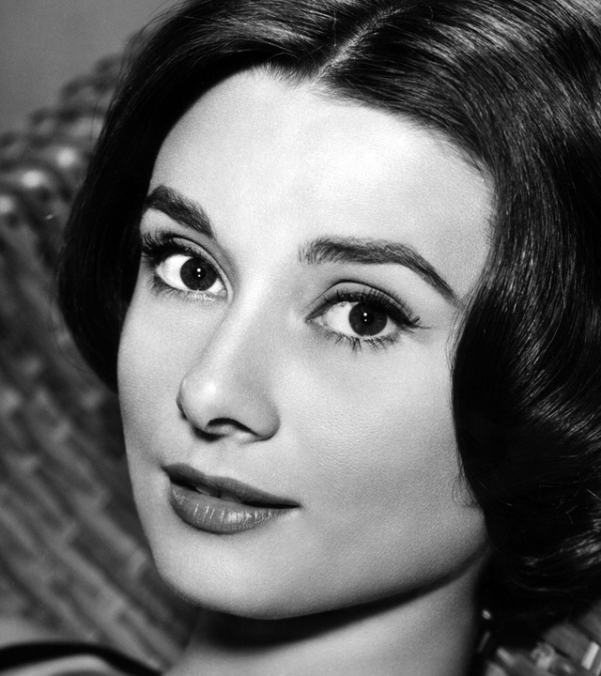
Source
Target
Our composite
Notes:
So if we look at the images we started out with, you can see that the final composite we get is able to match the source to the target and composite them to create a rather natural looking image.

Slide 51
Overview
Notes:
While the smooth histogram matching and pyramid compositing allows us to create good composites from most images, it turns out that sometimes the smooth histogram matching alone is not able to compensate for differences in the source and target images. In order to compensate for this, we introduce some noise into the harmonized pyramid that we match to the noise in the target pyramid in a manner that is very similar to the smooth histogram matching operation. The details for this are in the paper.

Slide 52
Overview
Notes:
This completes our pipeline for matching and compositing images, where in harmonization part we match the structure and the noise in the source image to that in the target image, and in the compositing we reconstruct the final result from the harmonized pyramid by applying the boundary constraints specified by the user.

Slide 53
Results
Notes:
Now let us look at the kind of composites we can create using our technique.

Slide 54
Matching color
Process images in CIELAB
Color matching using N-dimensional PDF transfer
[ Pitié et al. ’05 ]
Notes:
A quick note about color. Everything I have described to you work in grayscale. To handle color we convert the images to a decorrelated color space like LAB and apply our technique to each channel separately. In some cases, we also match the actual colors themselves using a method proposed by Pitie et al.

Slide 55
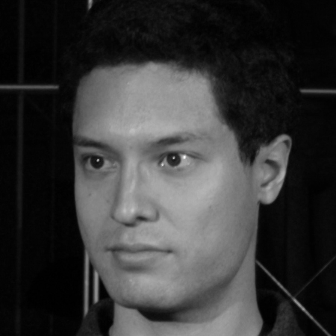
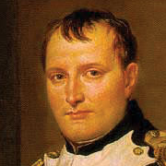
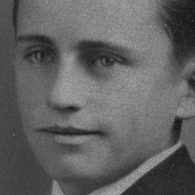
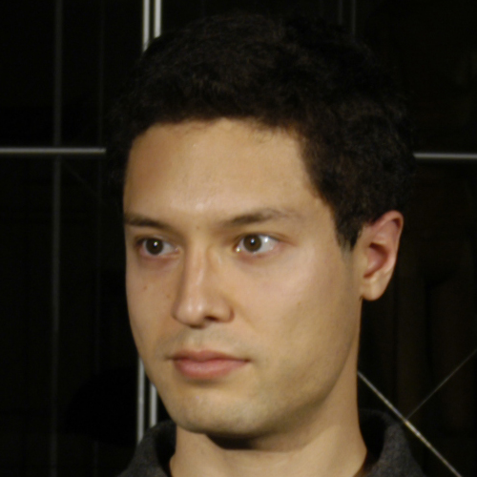
Matching contrast and noise
Source
Targets
Notes:
In our first example, we’d like to take the source image on the left and composite it into the two different targets on the right.

Slide 56
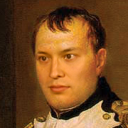
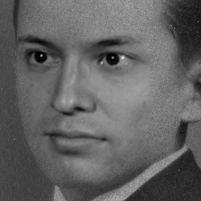
Gradient-
domain
fusion
Notes:
And as you can see the fact that the contrast and noise in the source are different from those in the target are obvious when you composite them using gradient-domain fusion.

Slide 57
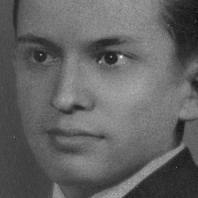
Gradient-
domain
fusion
Harmonization
Notes:
By harmonizing the images, our method is able to produce results that are much better. In addition, our harmonization scheme is able to automatically match the same source image to fairly different target images to produce the results here.

Slide 58
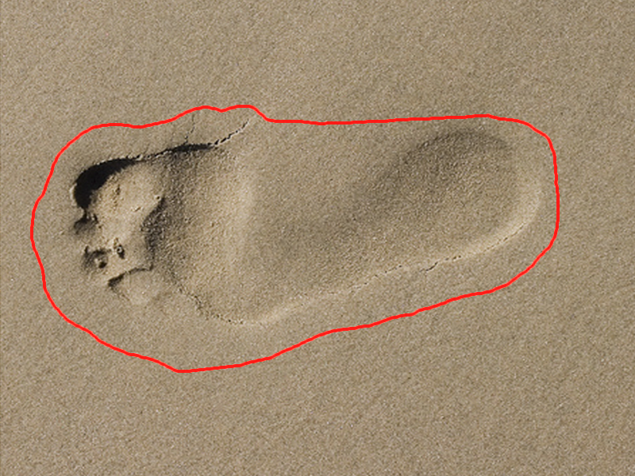
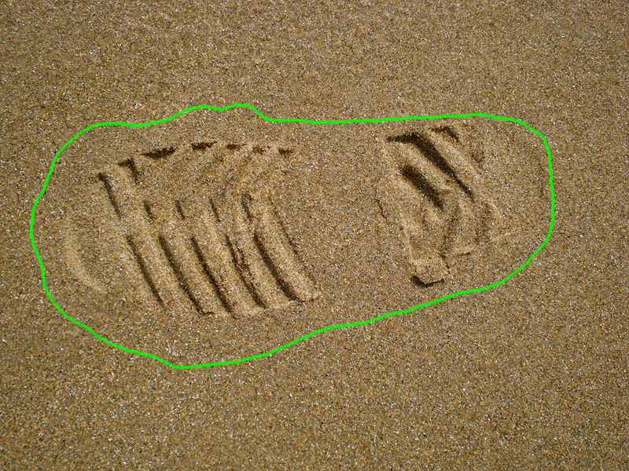
Matching texture
Source
Target
Notes:
You can use our technique to match the textures between images even when they are very different as in this example where we are compositing two images of footprints in sand.

Slide 59
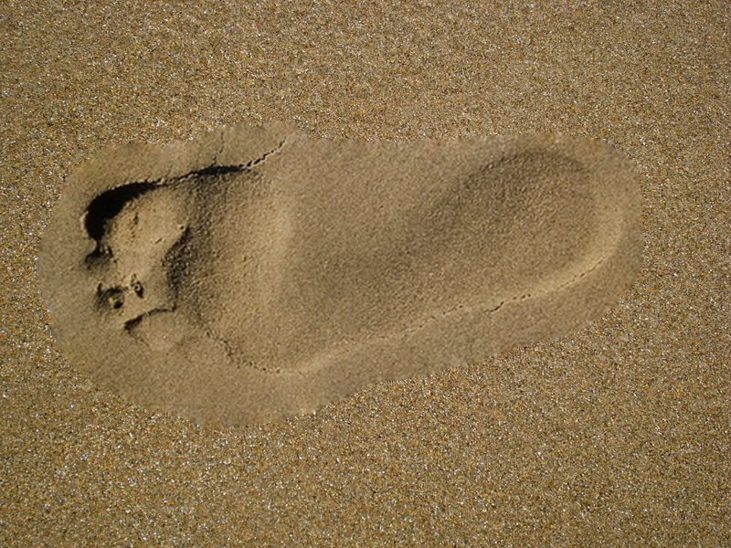
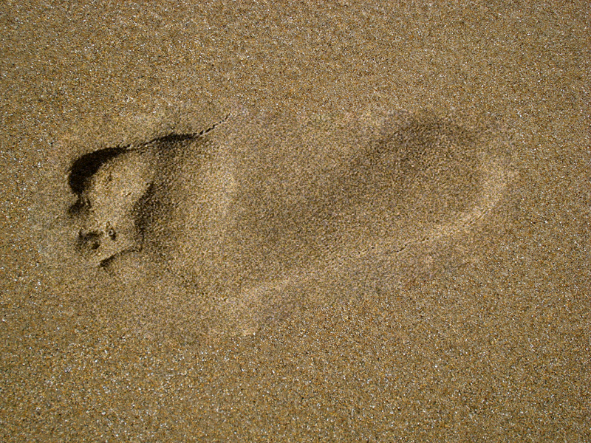
Gradient-domain fusion
Harmonization
Notes:
The differences in the two sand textures is perceptually clear in the gradient domain fusion result but by matching them our method makes it difficult to spot the actual boundary

Slide 60
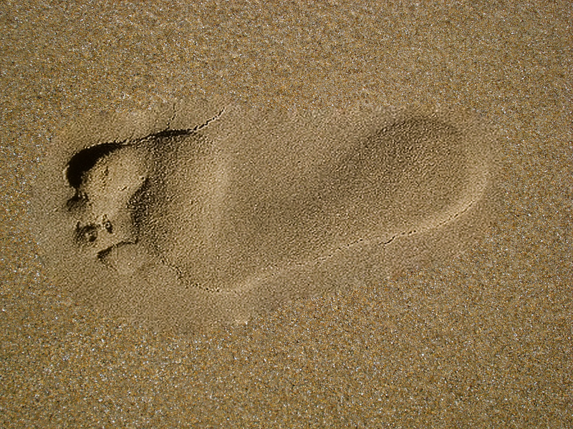
Harmonization
without noise matching
Harmonization
with noise matching
Notes:
This is in fact an example where the noise matching component helps us improve the quality of the result. On the left is the result without noise matching and as you can see while smooth histogram matching doesn’t try and match the target texture it is not able to do so very well. Adding the extra noise and matching it to the target texture improves the result substantially.

Slide 61
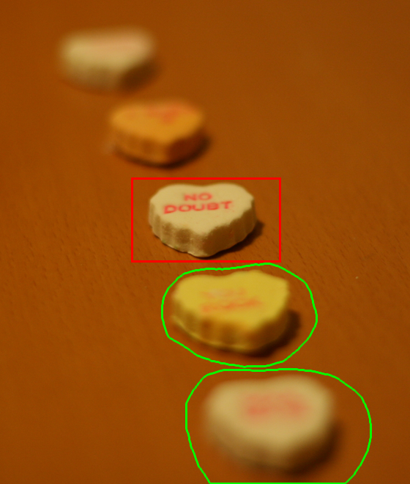
Matching blur
Source
Target
Original image
Notes:
Another interesting thing you can do with our technique is match the blur of images while compositing them. So in this example, we copied the red region and copied it over onto the green regions. Because of the shallow depth of field in the original image, these regions have very different blurs.

Slide 62
Original image
Harmonization
Notes:
But by harmonizing the regions we are able to match this blur and create a composite where we have edited the content of the photograph but retained the impression of a shallow depth of field.

Slide 63
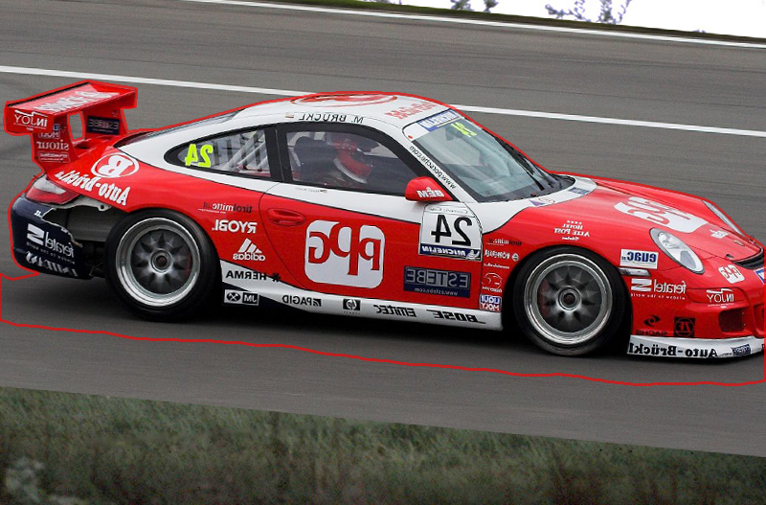
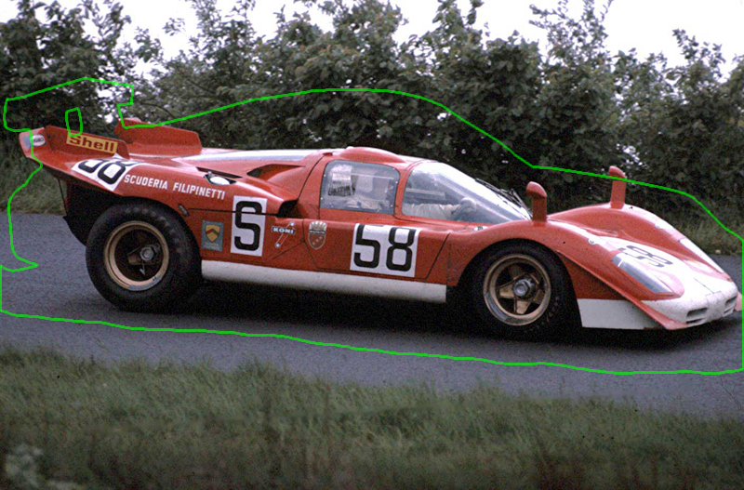
Compositing with mixed boundaries
Source
Target
Notes:
Finally, as I mentioned earlier, our pyramid compositing technique allows us to apply different types of boundary conditions in the same composite. I’ll illustrate that in this example where we are copying the Porsche from the image on the left and copying it onto an old photograph of a Ferrari.

Slide 64
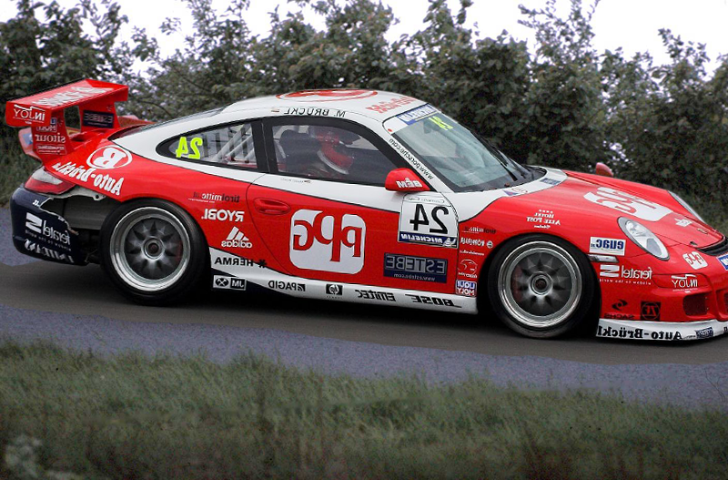
Alpha matting
Notes:
Simply matting the car in doesn’t produce a good result, because the car itself doesn’t match the old grainy photograph look of the background, and we have this seam on the road below.

Slide 65
Alpha
matte
Seamless
boundary
Alpha matting
Notes:
Ideally we’d want to alpha matte the new car in while ensuring that there is no boundary at the bottom i.e. the road in the target image transitions seamlessly to that in the source.

Slide 66
Boundaries
Notes:
We can do this by specifying an alpha matte shown in white here and also indicating that the region in red should be seamless

Slide 67
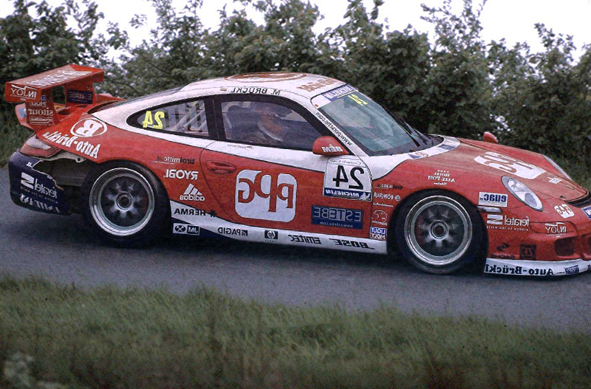
Harmonization
Notes:
Incorporating these two constraints allows us to create this result where we have harmonized and alpha-matted the car in to the background while removing the seam at the bottom.

Slide 68
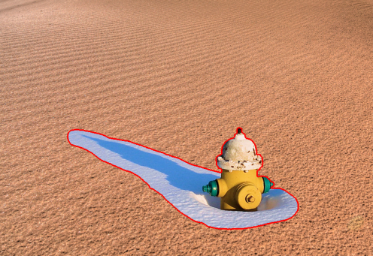
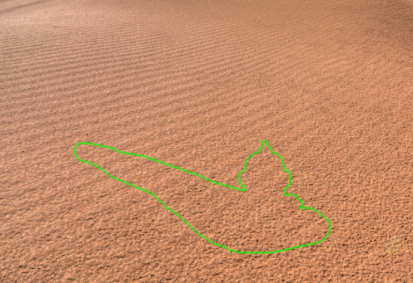
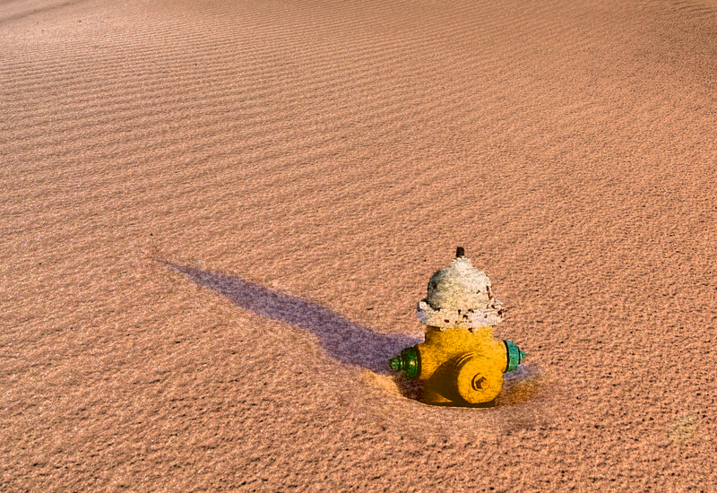
Limitations
Assumes that the source image is a good model
Handles only stochastic noise and textures
Notes:
Our technique does have some limitations. In particular, it assumes that the target is a good model to match the source. This is not always true as in this case of compositing a fire hydrant into sand. Also because of the way we are doing our harmonization, we can only handle stochastic noise and textures and will not be able to match structured textures like the sand here that flows from the bottom left to the top right.

Slide 69
Conclusions
Notes:
To conclude, we have presented a framework for compositing images

Slide 70
Conclusions
Notes:
That first uses a combination of a histogram matching and a noise matching technique to harmonize the images first

Slide 71
Conclusions
Notes:
And then composites them together using a pyramid compositing scheme

Slide 72
Conclusions
User-friendly image compositing
Notes:
Putting the two together gives us a versatile user-friendly compositing method that takes the burden of matching different aspects of visual appearance away from the user.

Slide 73
Future Work
Other visual cues
Shadows
Lighting
Complex noise and texture patterns
Structured noise
Other applications for “harmonization”
Videos
Notes:
There are other visual cues that decide how believable a composite is. Handling shadows and lighting in particular seems like a interesting problem. We’d like to extend our work to be able to handle more complex non-stochastic noise and texture patterns. Finally, we are interested in other applications where “harmonization” might be useful for example combining videos might be one such problem.

Slide 74
Acknowledgments
Micah K. Johnson acknowledges NSF support (Grant No. 0739255) and a gift from Adobe Systems
David Salesin and members of the Advanced Technology Labs, Adobe Systems
SIGGRAPH reviewers
Flickr users Bob.Fornal, freeparking, lrargerich, net_efekt, Okinawa Soba, patterbt, prorallypix, Scarto, Steve Wampler, teliko82, zsoltika
Notes:
We’d like to acknowledge the following people for their help.

Slide 75
Thank you!
Notes:
And thank you for your attention!

Slide 76
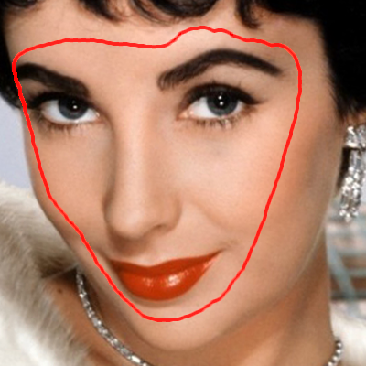
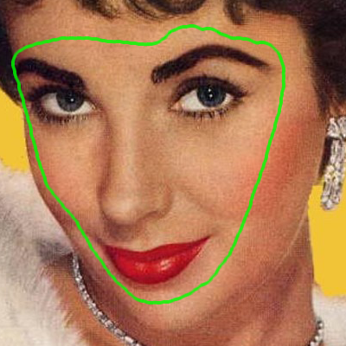
Source and Target

Slide 77
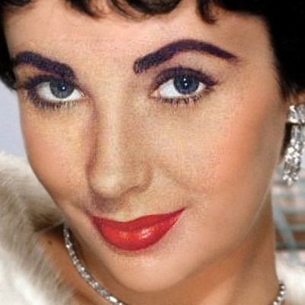
Gradient-domain fusion

Slide 78
(Remove noise)
Harmonization
(Add noise)

Slide 79
Source
Notes:
Drop some faces

Slide 80
Gradient-domain fusion

Slide 81
Harmonization

